Slide 1
HTML Tables
COMP 2511 - Web I: Client Development
Yasaman Amannejad,
Department of Mathematics and Computing,
Mount Royal University
Modified by Jim Davis

Slide 2
Tables
  Tables are frequently used to organize data into rows and columns.
  The table element defines an HTML5 table
  The summary attribute summarizes the table’s contents and is used by speech devices to make the table more accessible to users with visual impairments.
  The caption element specifies a table’s title.
  It’s good practice to include a general description of a table’s information in the table element’s summary attribute—one of the many HTML5 features that make web pages more accessible to users with disabilities.
    Speech devices use this attribute to make the table more accessible to users with visual impairments.
    <table summary=“Monthly savings for the Franks family”>

Slide 3
Tables
A table can be split into three distinct sections:
  Head (thead element)
    Table titles
    Column headers
  Body (tbody element)
    Primary table data
  Table Foot (tfoot element)
    Calculation results
    Footnotes
    Above body section in the code, but displays at the bottom in the page

Slide 4
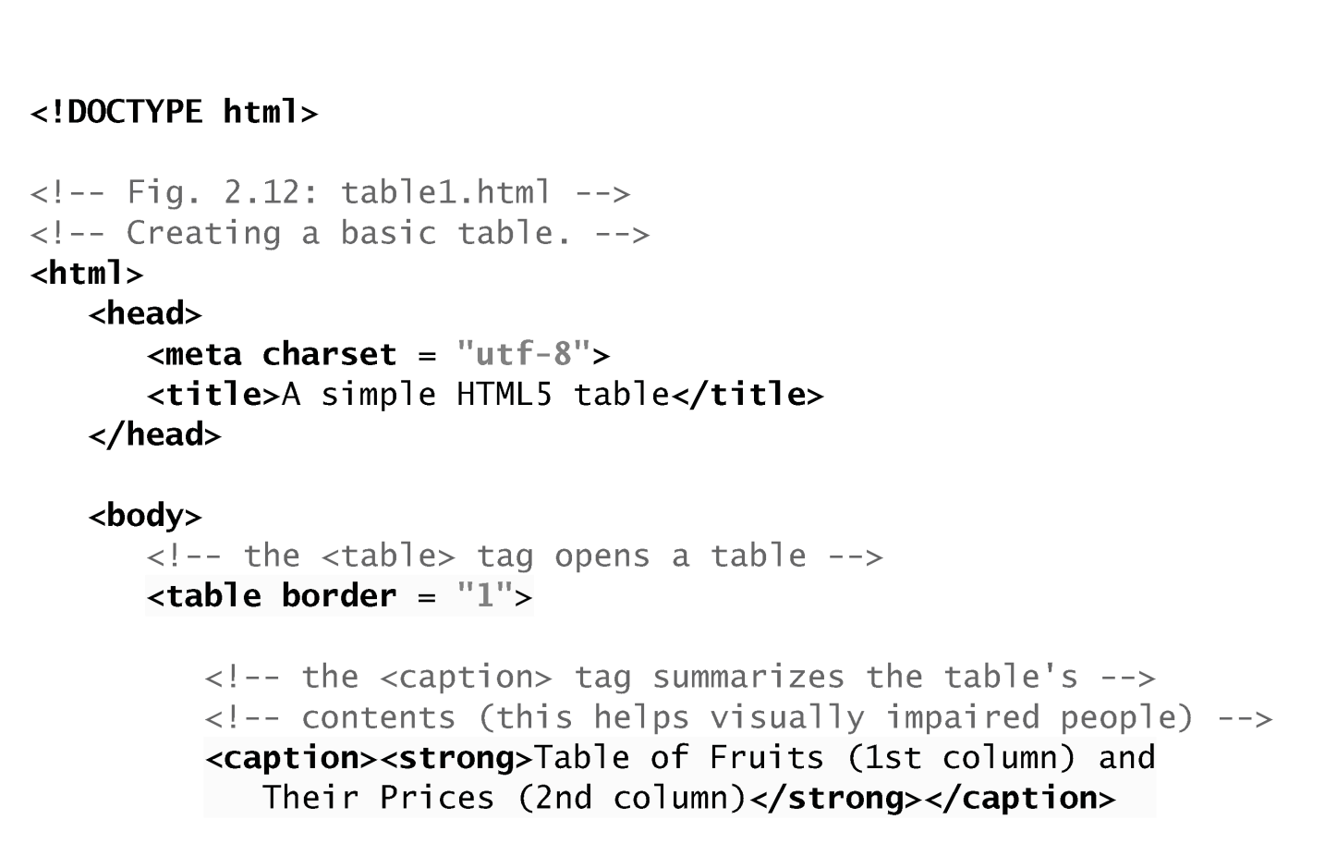
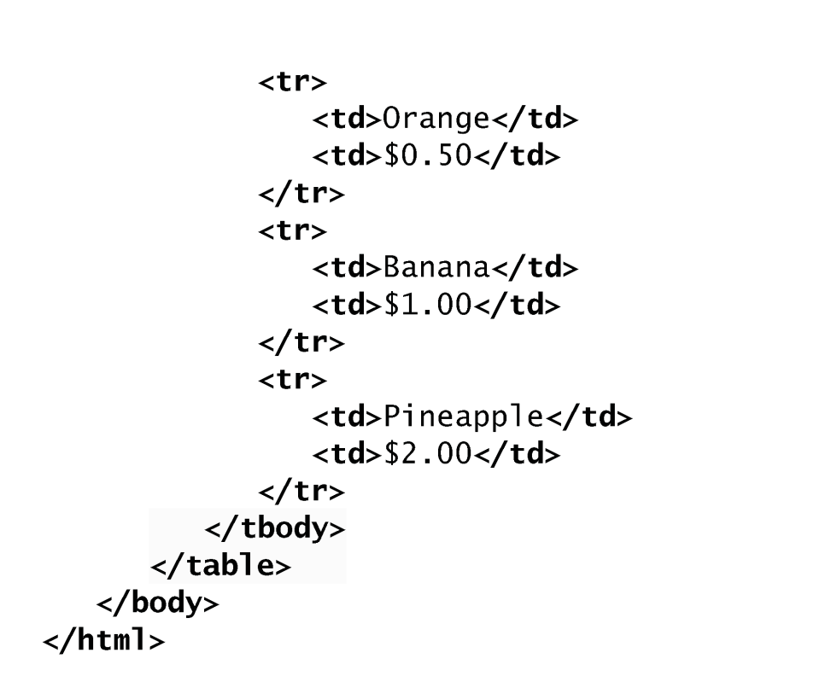
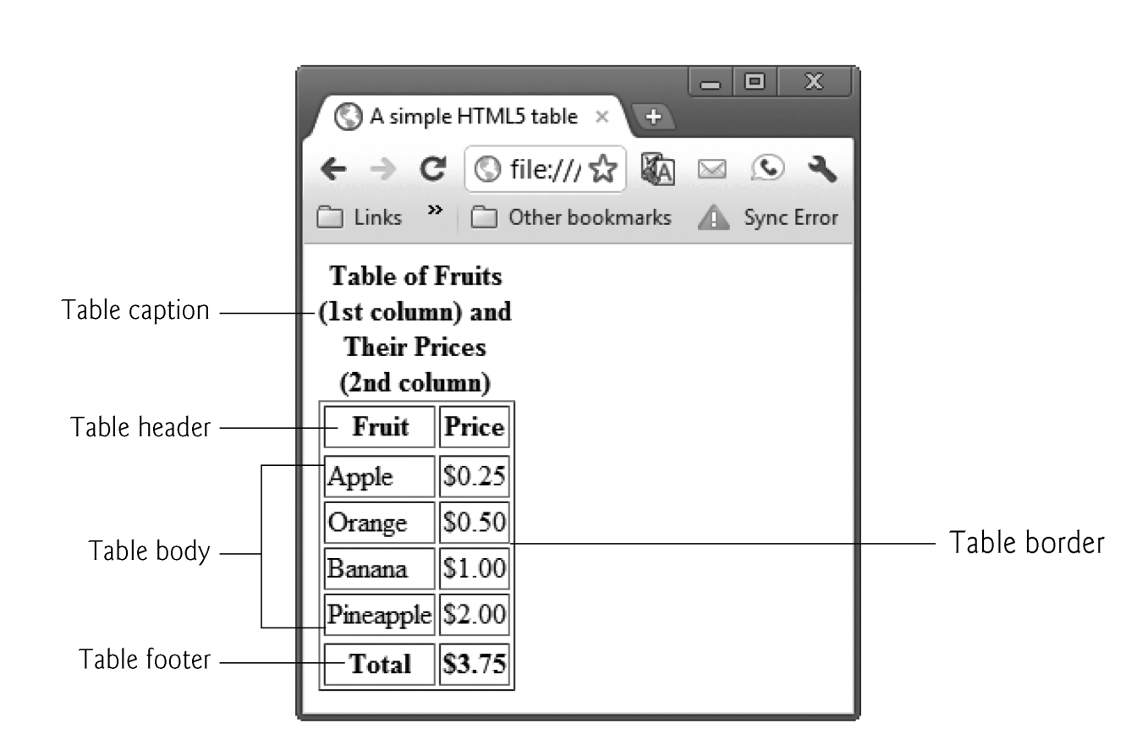
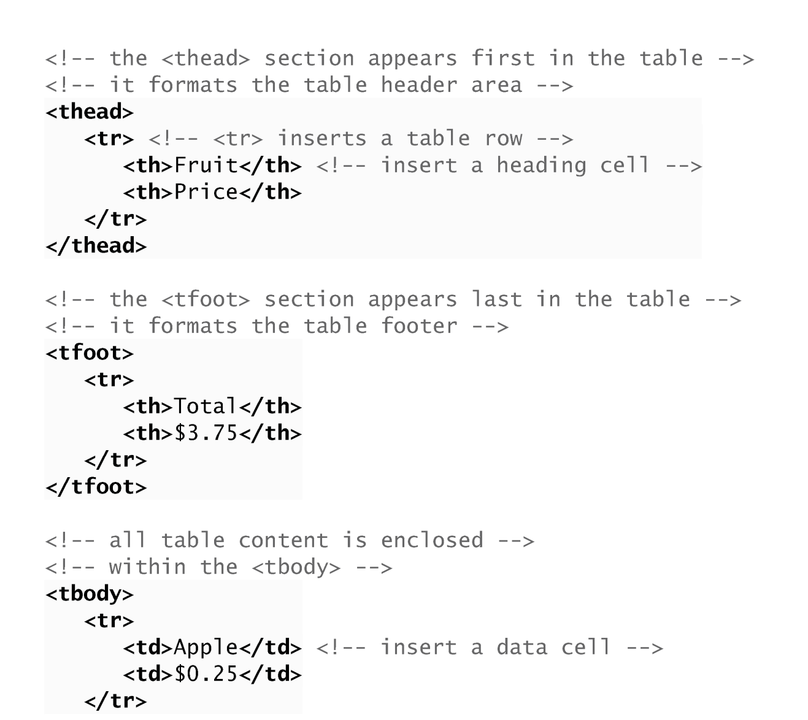

Slide 5
Tables
tr Element
  Defines individual table rows
  Element th
    Defines a header cell
Td Element
  Contains table data elements

Slide 6
Tables
Using rowspan and colspan with Tables
Figure 2.13 introduces two new attributes that allow you to build more complex tables.
You can merge data cells with the rowspan and colspan attributes
  The values of these attributes specify the number of rows or columns occupied by the cell.
  Can be placed inside any data cell or table header cell.
The br element is render as a line break in most browsers—any markup or text following a br element is rendered on the next line.
Like the img element, br is an example of a void element.
Like the hr element, br is considered a legacy formatting element that you should avoid using—in general, formatting should be specified using CSS.

Slide 7
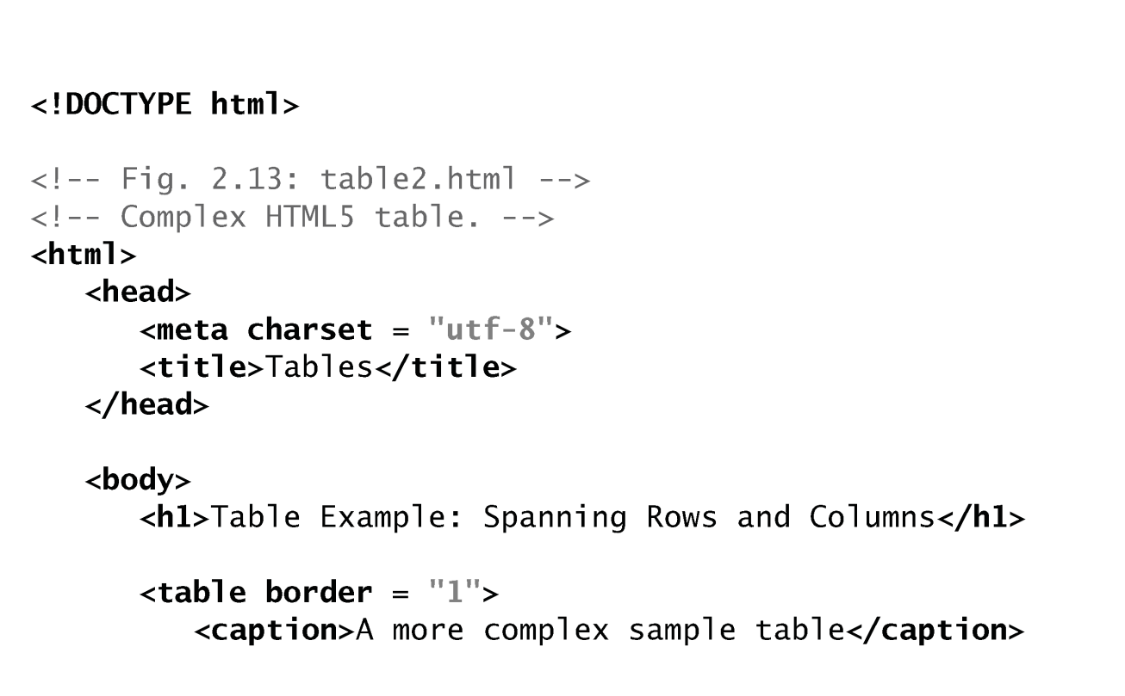
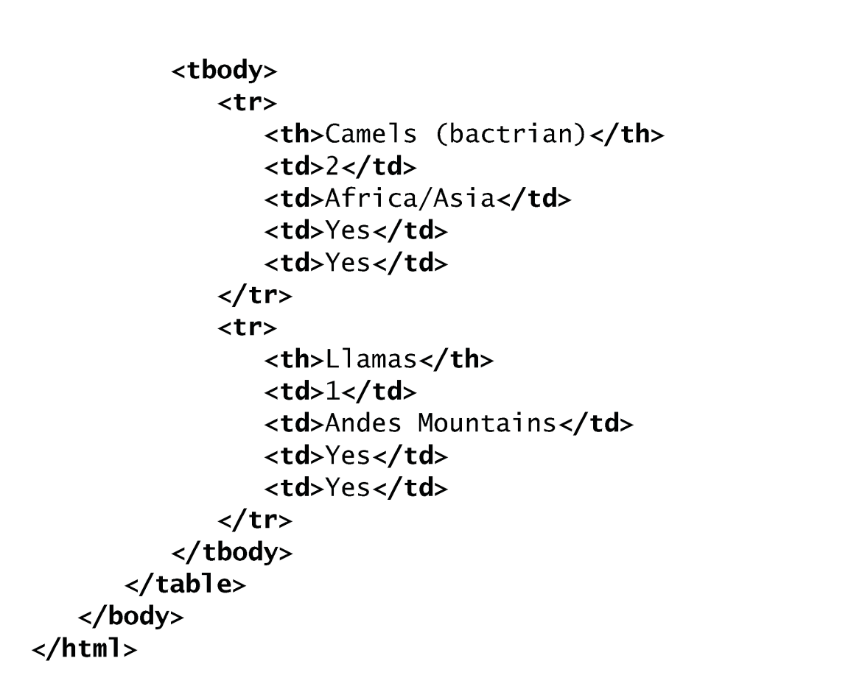
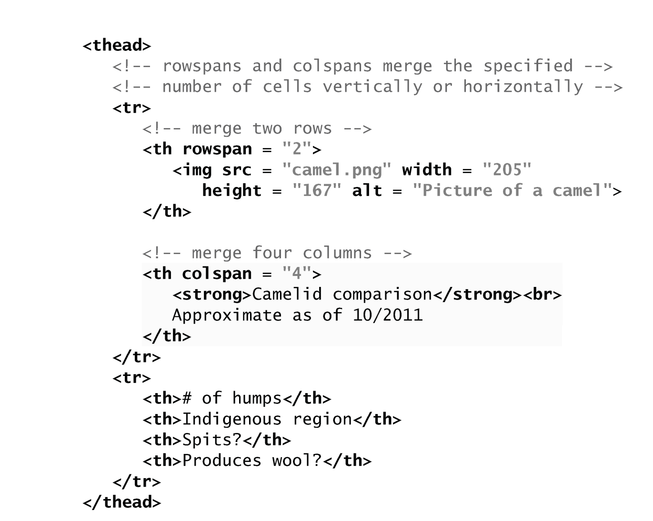
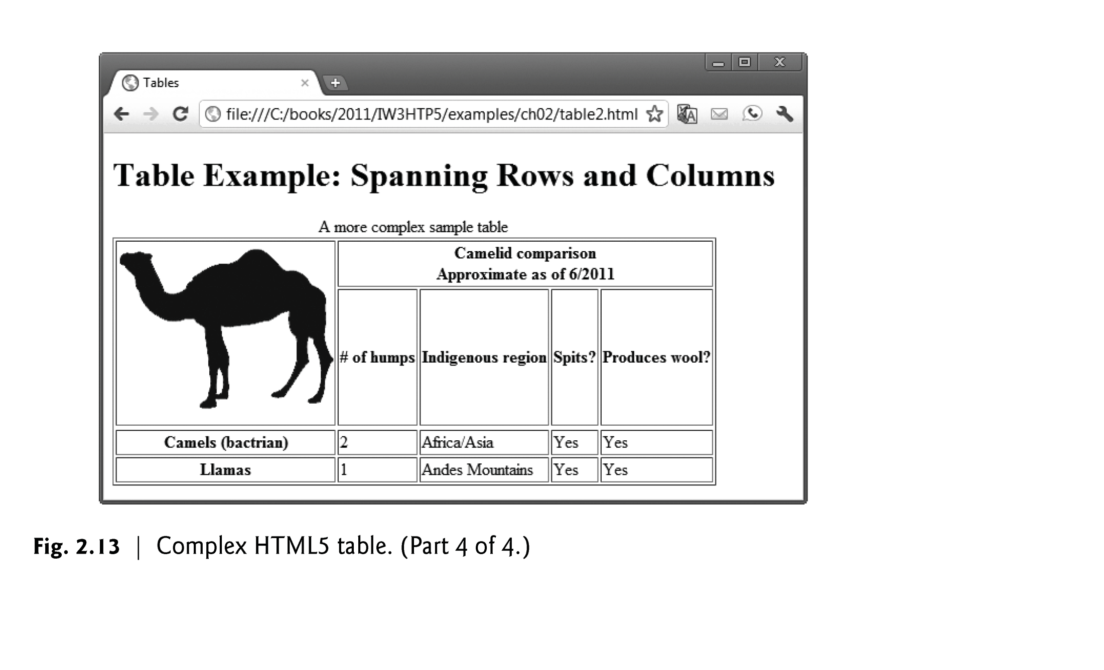

Slide 8
Any Question?

Slide 9
Tables
  Tables are frequently used to organize data into rows and columns.
  The table element defines an HTML5 table
  The summary attribute summarizes the table’s contents and is used by speech devices to make the table more accessible to users with visual impairments.
  The caption element specifies a table’s title.
  It’s good practice to include a general description of a table’s information in the table element’s summary attribute—one of the many HTML5 features that make web pages more accessible to users with disabilities.
    Speech devices use this attribute to make the table more accessible to users with visual impairments.
    <table summary=“Monthly savings for the Franks family”>

Slide 10
Tables
A table can be split into three distinct sections:
  Head (thead element)
    Table titles
    Column headers
  Body (tbody element)
    Primary table data
  Table Foot (tfoot element)
    Calculation results
    Footnotes
    Above body section in the code, but displays at the bottom in the page

Slide 12
Tables
tr Element
  Defines individual table rows
  Element th
    Defines a header cell
Td Element
  Contains table data elements

Slide 13
Tables
Using rowspan and colspan with Tables
Figure 2.13 introduces two new attributes that allow you to build more complex tables.
You can merge data cells with the rowspan and colspan attributes
  The values of these attributes specify the number of rows or columns occupied by the cell.
  Can be placed inside any data cell or table header cell.
The br element is render as a line break in most browsers—any markup or text following a br element is rendered on the next line.
Like the img element, br is an example of a void element.
Like the hr element, br is considered a legacy formatting element that you should avoid using—in general, formatting should be specified using CSS.

Slide 15
Any Question?

